Slide 1
LAN AND WAN ARCHITECTURE
Network architecture and classification
LAN topologies (Star, Ring, Bus, etc.)
Networking and internetworking devices (hub, routers, repeaters, switches, gateways)

Slide 2
NETWORK ARCHITECTURE AND CLASSIFICATIONS
Network architectures and standards refer to the frameworks, designs, protocols, and guidelines that govern the structure and functionality of computer networks. These architectures and standards ensure interoperability, efficiency, and security across various network devices and systems.
Generally, networks are distinguished based on their geographical span. Networks come in all sizes. They can range from simple networks consisting of two computers to networks connecting millions of devices. Depending on one’s perspective, we can classify networks in different ways. One way to categorize the different types of computer network designs is by their scope or scale. Common examples of area network types are:
Personal Area Network (PAN)
Local Area Network (LAN)
Metropolitan Area Network (MAN)
Wide Area Network (WAN)

Slide 3
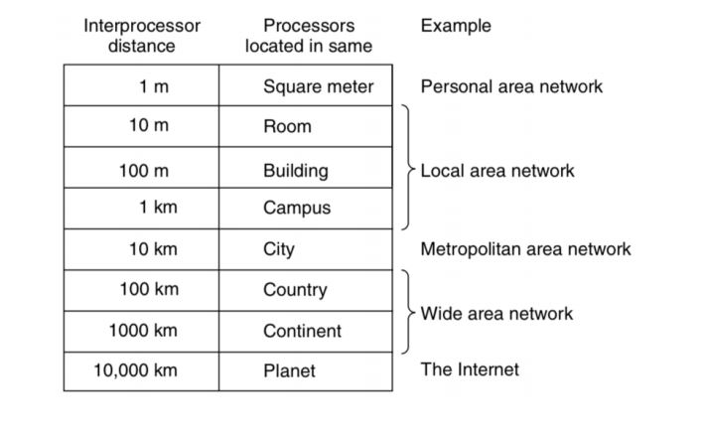
TYPES OF NETWORKS
Table 1: Classification of interconnected processors by scale

Slide 4
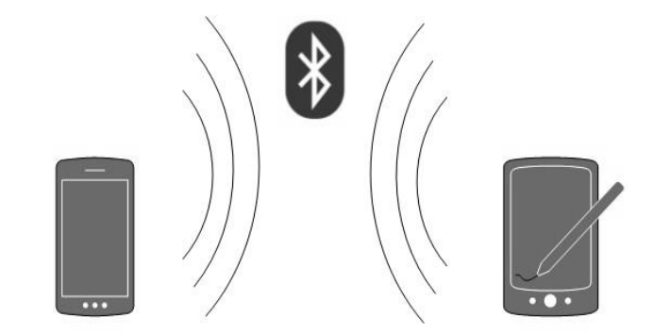
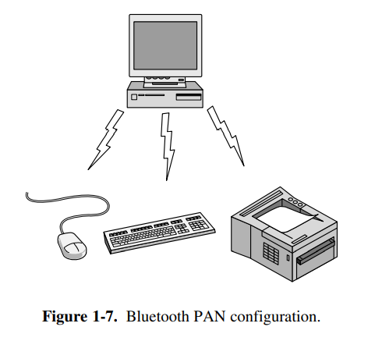
PERSONAL AREA NETWORK
A Personal Area Network (PAN) is the smallest network that is very personal to a user. A common example is a wireless network that connects a computer with its peripherals. Almost every computer has an attached monitor, keyboard, mouse, and printer. Without using wireless, this connection must be done with cables. To help these users, Bluetooth is used to connect these components without wires. It is often used to connect a headset to a mobile phone without cords and it can allow your digital music player to connect to your car merely being brought within range. A completely different kind of PAN is formed when an embedded medical device such as a pacemaker, insulin pump, or hearing aid talks to a user-operated remote control.
PAN has a connectivity range of up to 10 meters. For example, Piconet is Bluetooth-enabled Personal Area Network that may contain up to 8 devices connected in a master-slave fashion.
Figure 1: A Personal Area Network

Slide 5
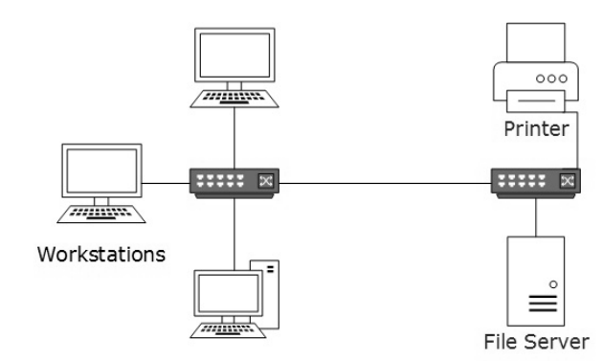
LOCAL AREA NETWORK
A local area network (LAN) is a network that connects computers and devices in a limited geographical area such as a home, school, computer laboratory, office building, or closely positioned group of buildings. Typically, wired LANs run at 100 Mbps to 1 Gbps speeds, have a low delay (microseconds or nanoseconds), and make very few errors. Newer LANs can operate at up to 10 Gbps. In addition to operating in a limited space, LANs are also typically owned, controlled, and managed by a single person or organization. They also tend to use certain connectivity technologies. Ethernet is the most widely employed LAN technology
LANs are composed of inexpensive networking and routing equipment. It may contain local servers serving file storage and other locally shared applications. It mostly operates on private IP addresses and does not involve heavy routing. LAN works under its local domain and it is controlled centrally. LAN can be wired, wireless, or in both forms at once.
Figure 2: A Local Area Network

Slide 6
LOCAL AREA NETWORK
They are widely used to connect personal computers and workstations in company offices and factories to share resources (e.g., printers), File transfers and access, electronic message handling, remote database access, personal computing, digital voice transmission and storage, other applications, etc.
LANs are distinguished from other kinds of networks by three characteristics: their size, their transmission technology, and their topology.
Usually, the server has applications and data storage that are shared in common by multiple computer users. A local area network LAN supplies networking capability to a group of computers near each other such as in an office building, a school, or a home. They often serve as the backbone for larger networks, such as Wide Area Networks (WANs), which connect multiple LANs across different locations.
Key characteristics of a LAN include limited geographic area, high data transfer rates, ownership and control, common communication medium, etc.

Slide 7
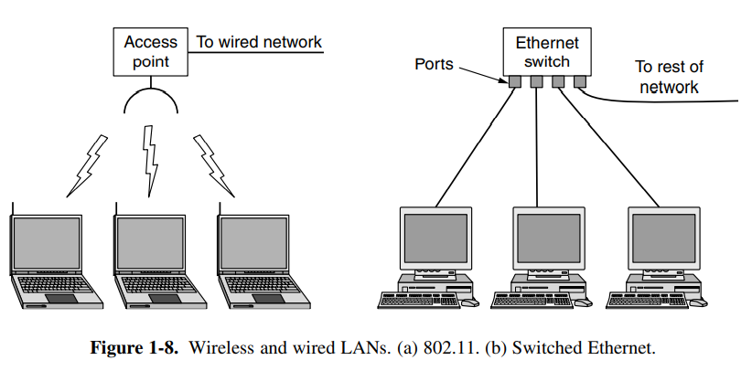
LOCAL AREA NETWORK
When LANs are used by companies, they are called enterprise networks. In these systems, every computer has a radio modem and an antenna that it uses to communicate with other computers. An access point, wireless router, or base station relays packets between the wireless computers and also between them and the Internet. There is a standard for wireless LANs called IEEE 802.11, popularly known as Wi-Fi, which has become very widespread.
Figure 3: Wireless LAN
Wired LANs use a range of different transmission medium. Most of them use copper wires, but some use optical fiber. The topology of many wired LANs is built from point-to-point links. IEEE 802.3, popularly called Ethernet, is, by far, the most common type of wired LAN.

Slide 8
ADVANTAGES OF LAN
Share resources efficiently
Individual workstation might survive network failure if it doesn’t rely upon others
Component evolution independent of system evolution
Supports heterogeneous hardware/software
Access to other LANs and WANs
High transfer rates with low error rates

Slide 9
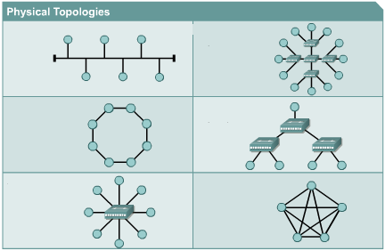
NETWORK TOPOLOGIES

Slide 10
NETWORK TOPOLOGIES
Topology refers to the layout of connected devices, i.e. how the computers, cables, and other components within a data communications network are interconnected. Physical topology describes how the network is actually laid out. Logical topology describes how the data actually flow through the network. A logical topology map groups hosts by how they use the network, no matter where they are physically located. Host names, addresses, group information, and applications can be recorded on the logical topology map.
A network topology diagram allows a network engineer to visualize how the devices are connected in the network. Network topology diagrams thus help a network engineer to maintain and troubleshoot the network.
Two most basic topologies are point-to-point and multipoint. A point-to-point topology usually connects two mainframe computers for high-speed digital information. A multipoint topology connects more stations through a single transmission medium. Examples are a star, bus, ring, mesh, and hybrid.

Slide 11
LAN TOPOLOGIES
It is very important to maintain and update physical topology maps to aid future installation and troubleshooting efforts. The physical topology map also shows where the wiring is installed and the locations of the networking devices that connect the hosts.
The physical topology of a local area network should have the following desirable features:
the topology should be flexible to accommodate changes in the physical locations of the stations, increase in the number of stations, and increase in the LAN geographic coverage.
the cost of physical media and installation should be minimum.
the network should not have any single point of complete failure.
There are several LAN topologies available in the industry. Bus topology, ring topology, and star topology are common. There can also be some other topologies such as distributed stars, trees, etc.

Slide 12
BUS TOPOLOGY
In a bus topology, a single transmission medium interconnects all the stations that share this medium for the transmission of their signals. The single cable, (the backbone) functions as a shared communication medium that devices attach or tap into with an interface connector. It is the simplest and most common method of interconnecting computers.
A device wanting to communicate with another device on the network sends a broadcast message onto the wire that all other devices see, but only the intended recipient actually accepts and processes the message. Every transmission has source and destination addresses so that stations can pick the data units meant for them and identify their senders. If two stations transmit simultaneously, the collision takes place. To avoid signal reflection, the ends of the bus are terminated into matching impedance called the head end.
The two ends of the transmission line never touch to form a complete loop. A bus topology is also known as a linear bus or a horizontal bus. If the geographic coverage needs to be expanded, repeaters that interconnect two buses are required.

Slide 13
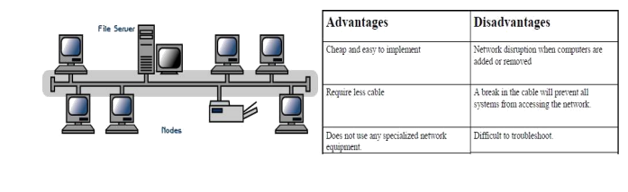
BUS TOPOLOGY
A repeater regenerates the signals of one bus into the other bus. It is transparent to the rest of the system in the sense that it does not have a buffer and interconnects the two sections of the LAN to make them virtually one section.
Advantages
It is quite simple to set up and it is low-cost.
It requires less cable length.
A single cable called a trunk (backbone, segment) is needed.
It is easy to extend.
If one station of the topology fails, it does not affect the entire system.
It is easy to connect a computer or peripheral to a linear bus.
Does not use specialized network equipment
Disadvantages
The entire network will shut down if there is a break in the main cable.
It is difficult to identify a problem if the entire network shuts down.
Any break in the bus is difficult to identify.
Bus cable can be a bottleneck when network traffic is heavy
There is network disruption when computers are added or removed
Figure 4: Bus Topology

Slide 14
RING TOPOLOGY
A ring network consists of several transmission links joined together in the form of a ring through repeaters called Ring Interface Units (RIU). All messages travel through a ring in the same direction (either "clockwise" or "counterclockwise"). Thus, each RIU receives the signals at its input and after regeneration, sends them to the RIU of the next station. Every data unit in the ring contains the source and destination addresses.
All the stations are interconnected to form a closed loop or circle. Transmissions are unidirectional and must propagate through all the stations in the loop. Each computer acts like a repeater.
When a circulating data unit passes through an RIU, the station connected to the RIU retains a copy of the data unit if the data unit is meant for it. Since the ring does not have an end, the data units will circulate continuously unless they are removed from the ring. The responsibility of removing a data unit after it has completed one round is given to the sending station. The destination station is not given this responsibility because it may be out of order or the destination address may be wrong.

Slide 15
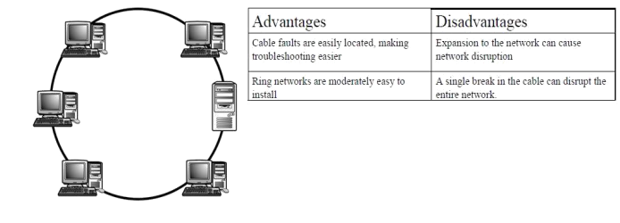
RING TOPOLOGY
The possibility of the sending station going out of order after transmitting a data unit cannot be ruled out and, therefore, a monitoring station is also required. It removes the data units going around a second time.
Advantages
Any signal transmitted on the network passes through all the LAN stations.
They offer high bandwidth and can span large distances
Cable faults are easily located making troubleshooting easier
Ring networks are moderately easy to install
The signal degeneration is low since each workstation participating in the network is responsible for regenerating the weak signal.
Disadvantage
A breakdown of any one station on the ring can disable the entire system.
Each time a new device is added, the entire ring must be disrupted to insert the new device. This can be cumbersome and time-consuming, especially in large networks.
Ring topologies are relatively expensive and difficult to install.
Ring down can happen when computers are added or removed from the network.
The cost of implementing a ring network can be higher compared to simpler topologies like bus or star due to the need for more cabling and potentially additional equipment like repeaters or bridges.
Figure 5: Ring Topology

Slide 16
STAR TOPOLOGY
A star topology is designed with each node (workstations and peripherals) connected directly to a central network hub or switch. Data on a star network passes through the hub or switch before continuing to its destination. The hub or switch manages and controls all functions of the network.
Each interconnection supports two-way communication. There can be two alternative communication approaches:
the central controller acts as a switch to route the data units from the source to the destination.
the central node can operate in broadcast mode. A frame from one station is transmitted to all other stations by the central node.
The use of star topology was initially restricted to small LAN installations. The high-speed LAN technology that was developed in the late nineties operated on point-to-point links. Today most of the LAN installations are based on star/tree topology using hubs and switches.

Slide 17
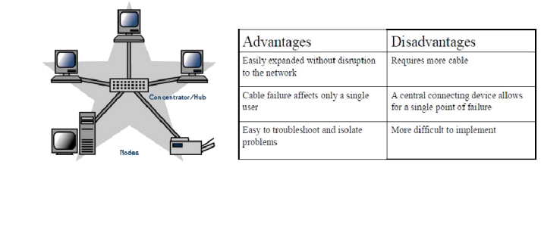
STAR TOPOLOGY
Advantages
Easily extended without disruption to the network
Cable failure affects only a single user
Easy to troubleshoot and isolate problems
It offers the flexibility of adding or deleting workstations from the network.
Disadvantages
Requires more cables
A failure of the central node will disable communication throughout the whole network.
More difficult to implement
The performance, as well as the number of nodes that can be added in such topology, will depend on the capacity of the central device.
Figure 6: Star Topology

Slide 18
MESH TOPOLOGY
The mesh topology incorporates a unique network design in which each computer on the network connects to every other, creating a point-to-point connection between every device on the network. Unlike each of the previous topologies, messages sent on a mesh network can take any of several possible paths from source to destination. A mesh network in which every device connects to every other is called a full mesh.
Mesh topology works well in a small network (Eg. Less than five devices). As the number of devices in the network increases, it becomes complex. It is used in WANs to interconnect LANs and for critical networks like those used by banks and financial institutions

Slide 19
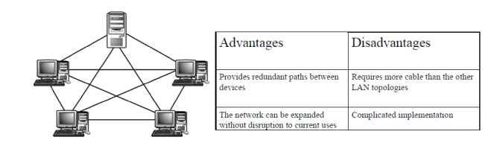
MESH TOPOLOGY
Advantages
Provides redundant paths between devices
The network can be expanded without disruption to current uses
It is highly reliable
Disadvantages
Requires more cables than the other topologies
Complicated implementation
It is not easy to troubleshoot a large full-mesh topology-based network
It is difficult to maintain and expand.
Figure 7: Mesh Topology

Slide 20
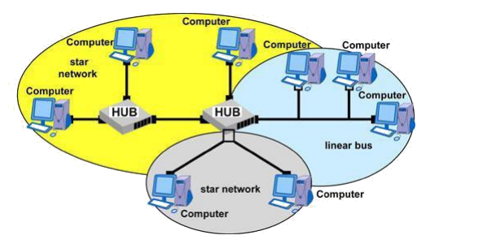
HYBRID TOPOLOGY
This topology is simply combining two or more of the traditional topologies to form a larger, more complex topology. The main aim is to be able to share the advantages of different topologies.
Figure 8: Hybrid Topology

Slide 21
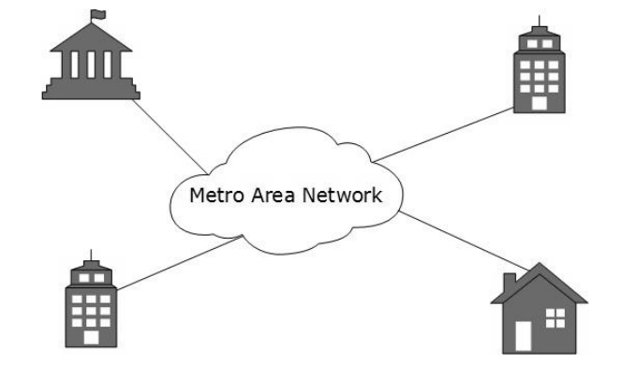
METROPOLITAN AREA NETWORK (MAN)
A Metropolitan Area Network (MAN) is a computer network that spans a larger geographic area than a local area network (LAN) but is smaller than a wide area network (WAN). A MAN typically covers a city or metropolitan area, connecting various LANs or other network devices across multiple locations within that region.
It can be in the form of Ethernet, token ring, ATM, or Fiber Distributed Data Interface (FDDI). Metro Ethernet is a service that is provided by ISPs. This service enables its users to expand their Local Area Networks. For example, MAN can help an organization connect all of its offices in a city. The backbone of MAN is high-capacity and high-speed fiber optics. MAN works in between LAN and WAN. MAN provides uplink for LANs to WANs or the internet.
Figure 9: Setup of a Metropolitan Area Network

Slide 22
METROPOLITAN AREA NETWORK (MAN)
Key characteristics of a Metropolitan Area Network include:
Larger Geographic Coverage: MANs cover a larger area than LANs, often spanning across a city or metropolitan region, connecting multiple LANs in different locations.
Interconnectivity: MANs facilitate the interconnection of LANs and other network devices, enabling data sharing and communication among different organizational units or branches within a metropolitan area.
High-Speed Connectivity: MANs often provide high-speed connectivity using technologies like fiber optics, microwave links, or other broadband solutions, enabling efficient data transmission over longer distances compared to LANs.
Managed by Multiple Entities: While LANs are typically managed by a single organization or individual, MANs might involve multiple stakeholders, such as telecommunications companies, local governments, or private entities, cooperating to create and maintain the network infrastructure.
Scalability: MANs are designed to accommodate growth and increased demand for network resources within a metropolitan area.
MANs are commonly used by universities, businesses, government agencies, and organizations that require network connectivity between multiple sites within a city or metropolitan region. They provide a balance between the limited coverage of LANs and the expansive reach of WANs, offering efficient communication and data-sharing capabilities over a larger geographical area.

Slide 23
WIDE AREA NETWORK (WAN)
A Wide Area Network (WAN) is a type of computer network that spans a large geographical area, typically connecting multiple local area networks (LANs) or metropolitan area networks (MANs) across different locations. WANs are designed to facilitate communication and data exchange between devices, computers, and networks that are geographically dispersed, often covering cities, countries, or even continents.
Key features of Wide Area Networks include:
Geographic Extent: WANs cover extensive distances and can connect devices and networks that are far apart, allowing for communication between locations separated by long distances.
Public and Private Infrastructure: WANs utilize a combination of public and private telecommunication networks, such as leased lines, satellites, fiber optics, microwave links, and the internet, to establish connections between different sites.
Reliability and Redundancy: WANs often incorporate redundancy and backup systems to ensure reliability. Redundant links and backup connections are commonly employed to prevent network downtime due to failures.
Lower Data Transfer Speeds: Compared to LANs or MANs, WANs often have slower data transfer rates due to the longer distances and diverse network infrastructures involved.
Managed by Multiple Entities: WANs may involve multiple service providers, organizations, or entities responsible for managing and maintaining the network infrastructure, depending on the network architecture and connections used.
WANs play a crucial role in enabling communication, resource sharing, and data transmission among different branches of organizations, connecting remote offices, facilitating access to centralized resources, and supporting various internet-based services and applications across a wide geographic area.

Slide 24
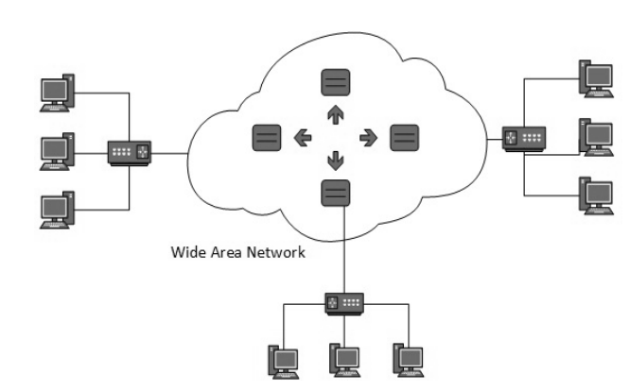
WIDE AREA NETWORK
It is possible to engineer data networks that can span cities, countries, and continents. Such data networks are called Wide Area Networks (WANs). The technology used in these networks does not have distance or scalability limitations. A wide area network consists of a collection of network nodes that provide resources for the interconnection of the end systems.
WAN spans a large geographical area, often a country or continent. It contains a collection of machines intended for running user (i.e., application) programs. These machines are called hosts. It uses long-range telecommunication links to connect two or more LANs/computers housed in different places far apart. Eg. States, Countries or across Globe (WAN spans over large geographic locations)
The hosts are owned by the customers (e.g., people's personal computers), whereas the communication subnet is typically owned and operated by a telephone company or Internet service provider.
In most wide-area networks, the subnet consists of two distinct components: transmission lines and switching elements. Transmission lines move bits between machines.
Figure 10: The Setup of a Wide Area Network

Slide 25
WIDE AREA NETWORK
Generally, telecommunication networks are Wide Area Networks. These networks provide connectivity to MANs and LANs. Since they are equipped with a very high-speed backbone, WANs use very expensive network equipment. WAN may use advanced technologies such as Asynchronous Transfer Mode (ATM), Frame Relay, and Synchronous Optical Network (SONET). WAN may be managed by multiple administrations. WANs interconnect the following:
metropolitan-area networks
campus-area networks
local-area networks
The transmission media used are normally telephones, optical fiber, microwaves, and satellite links. Users must purchase telecommunications services from an external provider.
Remote data entry is possible in WAN. It means sitting at any location, you can enter data, update data, and query other information on any computer attached to the WAN. An organization spread over many cities can keep its important business data on a single site. Computer conferencing is another use of WAN where users communicate with each other through their computer system.
It has dedicated point-to-point lines and most use a store-and-forward packet-switched technology to deliver messages. Internet Service Providers (ISPs) provide connectivity solutions for WAN. It is nearly impossible for small to medium organizations to pull network cables between their offices in two different countries located 1000s of km away.

Slide 26
USES OF WAN
Communication Facility: For a big company spanning over the country the employees can save long-distance phone calls and it overcomes the time lag in overseas communications.
Computer conferencing is another use of WAN where users communicate with each other through their computer system.
Remote Data Entry is possible in WAN. It means sitting at any location you can enter data, update data, and query other information of any computer attached to the WAN.
Centralized Information: This means if the organization is spread over many cities, they keep their important business data in a single place. WAN permits the collection of this data from different sites and saving at a single site.

Slide 27
DIFFERENCE BETWEEN LAN AND WAN
LAN | WAN
LAN is restricted to a limited geographical area of few kilometers. | WAN covers great distance and operate nationwide or even worldwide.
The computer terminals and peripheral devices are connected with wires and coaxial cables. | There is no physical connection. Communication is done through telephone lines and satellite links.
Cost of data transmission in LAN is less because the transmission medium is owned by a single organization. | The cost of data transmission is very high because the transmission medium used are hired, either telephone lines or satellite links.
The speed of data transmission is much faster Few data transmission errors | The speed of data transmission is slower Less data transmission errors

Slide 28
THE USES OF A NETWORK
File Management (Sharing, transferring)
Data files are shared (Access can be limited)
Shared files stored on a server
Application sharing (software can be shared)
Shared peripheral devices (printers, modems)
Personal communication(Email, Instantaneous communication)
Conferencing (teleconferencing, video-conferencing, audio-conferencing, data-conferencing)
Voice over IP (Phone communication over network wires)
Easier data backup

Slide 29
CHARACTERISTICS OF A NETWORK

Slide 30
NETWORK AND INTERNET DEVICES
Network devices are components used to connect computers as well as other electrical devices to share resources such as printers and fax machines. Depending on the size of the organization's network, different models of different capacities and quantities are used in the network. Different devices or components used in networking include hubs, switches, routers, network bridges, gateways, firewalls, wireless Access points (AP), etc.
HUB
It is a network device that sends one signal to all of the stations connected to it. Hubs are used in star topology networks, but they are often used with other configurations to make it easy to add and remove computers without bringing down the network.
A hub is installed at layer 1 and contains multiple ports that are used to connect hosts to the network. Hubs do not have the intelligence to understand or process higher-layer data, such as MAC addresses or IP addresses, making them limited in terms of network management and efficiency. A network hub receives traffic from a device in the port where the device is connected. The Ethernet hub then forwards the received traffic out to all its other ports.

Slide 31
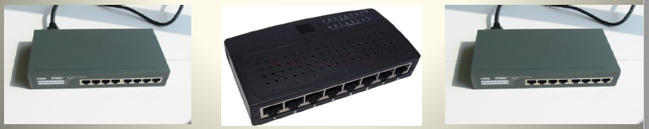
HUB
As a result, all the clients in the network receive the traffic which is a burden to other clients who are not the intended recipients. This nature of operation of Ethernet hubs can cause a large amount of unnecessary traffic in the network.
It is possible for two or more hosts connected to a hub to send messages at the same time. The messages can collide with each other. A collision causes the messages to become corrupted and unreadable by the hosts. The area of the network where a host can receive a corrupted message resulting from a collision is known as a collision domain.
After the collision, each sending host waits a short amount of time and then attempts to send, or retransmit the message again. As the number of hosts connected to the hub increases, so does the chance of collisions.
Figure 11: A Hub receiving data packet and passing it on to all the computers
Figure 6: Image of a Hub

Slide 32
SWITCH
A switch has the capability to learn which devices are connected to its ports. Switches learn about connecting devices by using a unique device address called the Media Access Control (MAC). A MAC address table contains a list of all of the active ports and the host MAC addresses that are attached to them. A Switch operates at the Data Link layer (Layer 2) of the OSI model.
Unlike hubs, which simply broadcast data to all devices in the same network segment, switches are much more efficient as they can selectively forward data to the specific device that needs it. Switches are widely used in modern networks to segment and manage traffic, improve network performance, and enhance network security. They play a crucial role in creating local area networks (LANs) and are a fundamental component of most network infrastructures.
Figure 12: Image of a Switch

Slide 33
SWITCH
When a message is sent between hosts, the switch checks to see if the destination MAC address is on the table. If it is, the switch builds a temporary connection, called a circuit, between the source and destination ports. This new circuit provides a dedicated channel over which the two hosts can communicate.
That is Layer 2 switch can forward the packet only to the intended recipient, not to every device in the network. A new circuit is built for every new conversation between hosts. These separate circuits allow many conversations to take place at the same time, without collisions occurring. Switches are a better option than hubs for larger networks or home networks with 4 or more connected computers. Switches can also send and retrieve information at the same time.
Figure 13: A Switch sending a packet to the intended destination

Slide 34
DIFFERENCES BETWEEN A HUB AND A SWITCH
Hub | Switch
1. It is a layer 1 device | 1. It is a layer 2 device
2. It works at the physical layer | 2. It works at the data link layer
3. It has no memory | 3. It has memory and stores the MAC address Table
4. Flood the network due to broadcasting | 4. Can be unicasting, multicasting and broadcasting
5. Security risks are high | 5. Security risks are low
6. Less efficient | 6. More efficient
7. Half duplex (Can send data or receive data but not at the same time.) | 7. Full duplex (Can send and receive data at the same time)

Slide 35
ROUTER
A router is a networking device that connects a local network to other local networks (remote networks) at Layer 3 of the OSI reference model of the network. Routers are key networking devices that use logical addressing, such as IP (Internet Protocol) addresses, to make decisions about how to forward data across different network segments.
To do this, routers must use both Address Resolution Protocol (ARP) and routing tables to store information. ARP finds the hardware address, also known as the Media Access Control (MAC) address, of a host from its known IP address. The packet format contains the IP addresses of the destination and source hosts, as well as the message data being sent between them.
The router reads the network portion of the destination IP address and uses it to find which one of the attached networks is the best way to forward the message to the destination. Routers facilitate communication within this internetwork. It decides how to send packets within the network so that they arrive at their destination.
Figure 14: Image of a Router

Slide 36
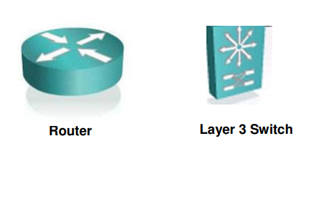
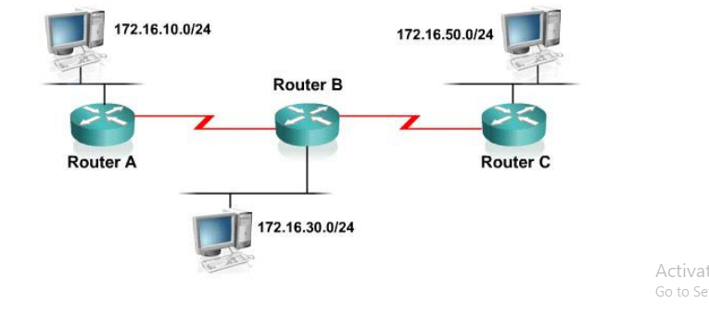
ROUTER
A router is a type of internetworking device that passes data packets between networks, based on Layer 3 addresses. The primary function of a router is to determine the best path to forward packets based on the information in its routing table and to forward packets toward their destination.
A router can make intelligent decisions regarding the best path for the delivery of data on the network. Routers are responsible for tasks like determining the best path for data to travel between networks, providing network address translation (NAT) to allow multiple devices to share a single public IP address, and enforcing network policies, including security and access control.
They play a critical role in connecting different local area networks (LANs) and wide area networks (WANs) and enable communication between devices on separate networks.
Figure 14: Path for delivering data

Slide 37
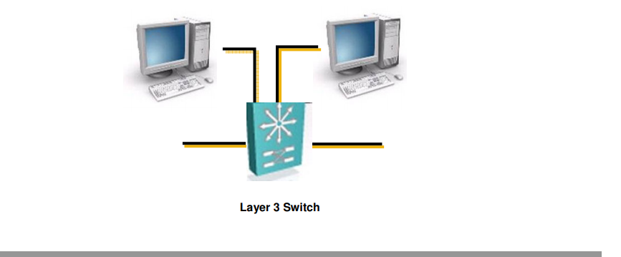
LAYER 3 SWITCHES
The Layer 3 switch functions at the Network layer and performs the multiport, virtual LAN, and data pipelining functions of a standard Layer 2 switch. It can also perform basic routing functions between virtual LANs.
A Layer 3 switch is a switch that performs routing functions in addition to switching.
Figure 15: Layer 3 Switch

Slide 38
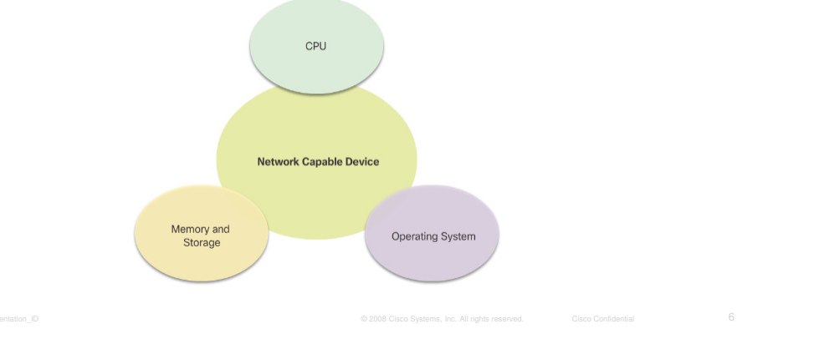
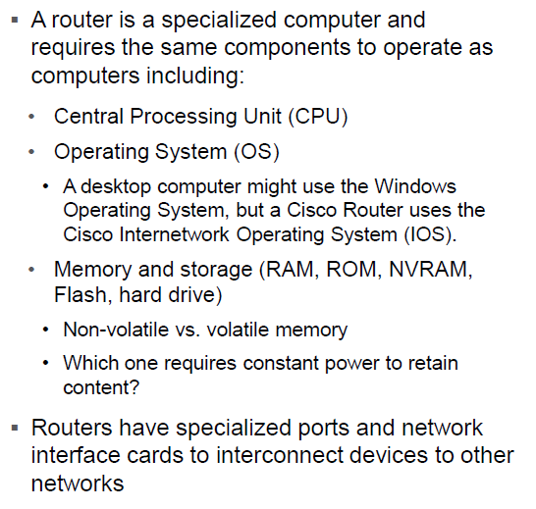
ROUTERS ARE COMPUTERS

Slide 39
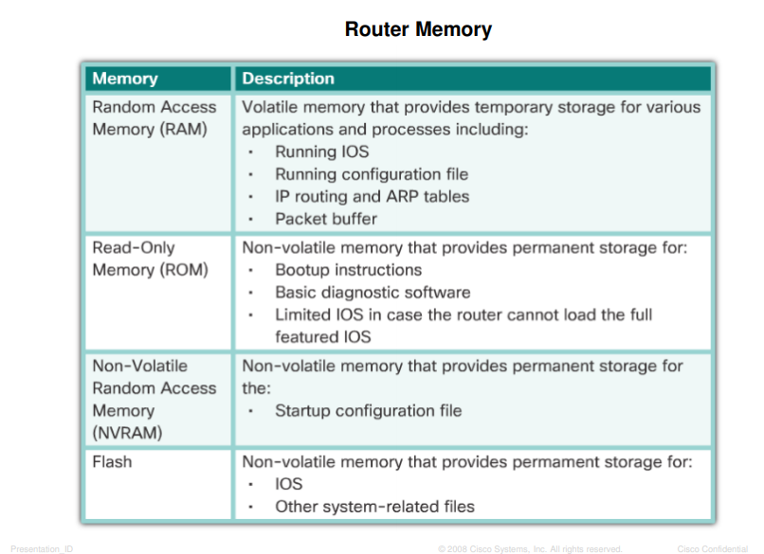
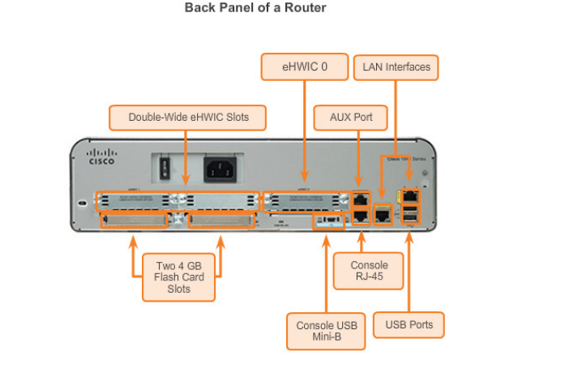
ROUTERS ARE COMPUTERS
Routers use specialized ports and network interface cards to interconnect to other networks.
Figure 16: Back panel of a Router

Slide 40
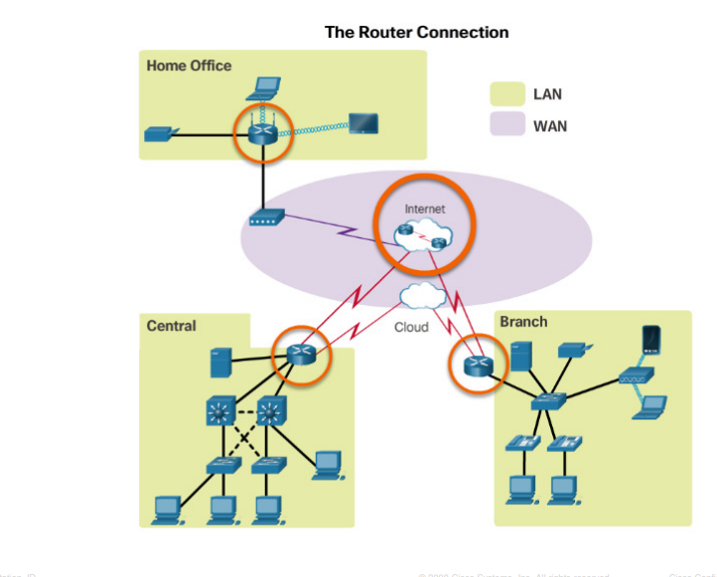
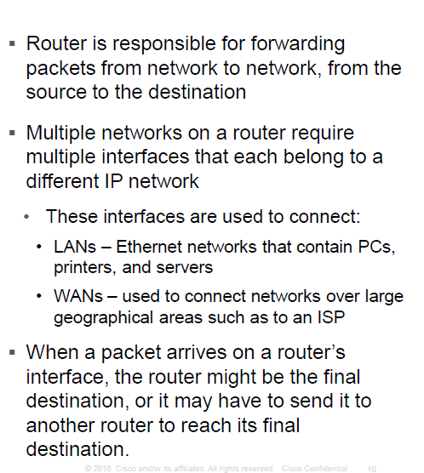
WHY ROUTING
Figure 17: The Router Connection

Slide 41
DEFAULT GATEWAY
When a host needs to send a message to a remote network, it must use the router. A host is given the IP address of the router through the default gateway address configured in its TCP/IP settings. The default gateway address is the address of the router interface connected to the same local network as the source host.
All hosts on the local network use the default gateway address to send messages to the router. Once the host knows the default gateway IP address, it can use ARP to determine the MAC address. The MAC address of the router is then placed in the frame, destined for another network.
BRIDGE
A bridge operates at the Data Link Layer, which is Layer 2 in the OSI (Open Systems Interconnection) model. The Data Link Layer is responsible for the reliable transmission of data over a physical medium and provides mechanisms for addressing, framing, and error detection.

Slide 42
BRIDGE
However, their primary function is to connect different network segments to form a single logical network. They use MAC (Media Access Control) addresses to make decisions about whether to forward or filter traffic between these segments. Bridges are often used to reduce network traffic, improve network performance, and isolate collision domains in Ethernet networks.
It is transparent to protocols and higher-level devices like routers. Each bridge consists of a MAC address and operates at layer 2 of the OSI model. When a packet is received on the bridge ports the forwarding table including the MAC address is automatically updated to map the source MAC address to the network port from which the packet originated. The gateway then processes the received packet according to the packet’s type.
Figure 18: Wireless Communication using a Bridge

Slide 43
REPEATER
Used to boost the signal between two cable segments or wireless access points. Does not simply amplify the signal, it regenerates the packets and retimes them. Resides on Layer 1 of the OSI model.
Figure 19: Image of a Repeater

